Slide 1
2020 Election Impact: Immigration Outlook
Gabrielle Lessard
lessard@nilc.org

Slide 2
National Immigration Law Center (NILC)
Mission: to defend & advance the rights & opportunities of low-income immigrants and their family members
Three integrated strategies: policy analysis and advocacy, impact litigation, strategic communications
www.nilc.org
Notes:
We do not represent individuals. Presentation is general information, not legal advice

Slide 3
Protecting Immigrant Families
Coalition of over 500 active member organizations
Our mission is to unite to advance, protect and defend access to health care, nutrition programs, public services and economic support for immigrants and their families at the local, state and federal level.
Joint project of NILC and CLASP
www.protectingimmigrantfamilies.org

Slide 4
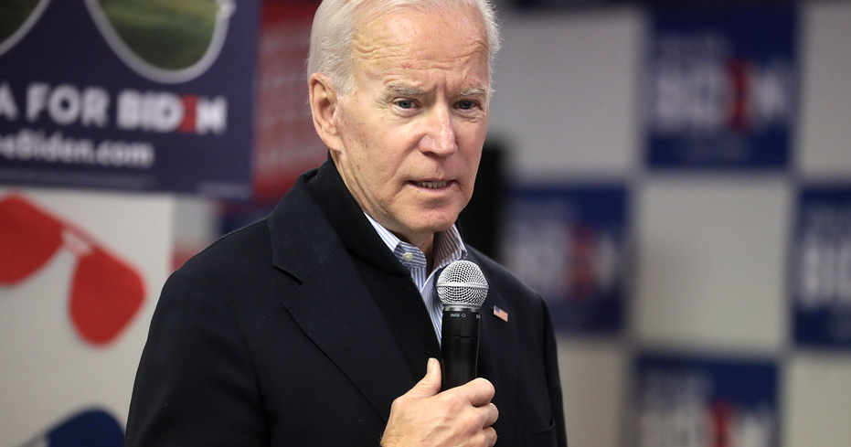
Priorities and Opportunities

Slide 5
Biden Immigration Priorities
As president, Biden will forcefully pursue policies that safeguard our security, provide a fair and just system that helps to grow and enhance our economy, and secure our cherished values. He will:
Take urgent action to undo Trump’s damage and reclaim America’s values
Modernize America’s immigration system
Welcome immigrants in our communities
Reassert America’s commitment to asylum-seekers and refugees
Tackle the root causes of irregular migration
Implement effective border screening
https://joebiden.com/immigration/
Notes:
toplines, detailed policy recommendations under each – campaign promises

Slide 6
Alejandro Myorkas
Nominee for Secretary of the Department of Homeland Security
Obama Director of US Citizenship and Immigration Services
NILC statement:
This represents an exemplary choice that will not only serve our next president and the American people well, but also sends a strong signal to immigrant communities that the Biden administration fully intends to follow through on its commitment to undo the harms of the Trump administration.

Slide 7
Legislation
President-Elect Biden commits to working with Congress on proposals that include:
Passing an immigration reform bill that provides a pathway to citizenship for undocumented residents
Create a new visa category for family members who must often wait years for a visa
Increasing the number of visas available for survivors of domestic violence and other crimes
Composition of Congress is likely to limit success

Slide 8
Administrative Changes
Notes:
Immigration Policy tracking project – Lucas Guttentag, Stanford
Restricting access to asylum
Travel bans
‘extreme vetting’ policies that slow processing of applications and petitions
Limiting the discretion of immigration judges

Slide 9
Possibilities and Limitations
The Trump Administration has made over 400 changes to immigration policy through administrative mechanisms
These can be changed by the Executive Branch, acting alone, but there are processes must be followed to survive legal challenges

Slide 10
Regulations
The Biden Administration could adopt new regulations to replace existing regulations. The process of adopting the regulations would have to comply with the Administrative Procedure Act (APA)
APA compliance normally requires to Administration to accept and respond to public comments before new regulations go into effect
In some circumstances, an Administration can adopt an Interim Final Rule, which goes into effect immediately, with a subsequent comment period – possibly vulnerable to legal challenges
It may be possible for the Administration to settle legal challenges to the existing regulations to keep them from being enforced while it goes through a rulemaking process

Slide 11
Example: Public Charge
A public charge is a person who is dependent on the government
A person who is deemed likely to become a public charge in the future can be denied lawful permanent resident (LPR) status (aka green card) or permission to come to the US
Department of Homeland Security regulations that went into effect on Feb. 24, 2020 defined a public charge as a person who received certain public benefits, including Medi-Cal and CalFresh for a minimum period of time and created a ‘wealth test’ that makes it harder for low and moderate income people to succeed
Many immigrant families are avoiding public benefits due to these policies
The President-Elect has committed to reversing these regulations but must follow the APA process

Slide 12
Proposed Regulations
A regulation that has been proposed but not finalized can be withdrawn
Example: HUD mixed-status family rule
Only certain categories of immigrants are eligible to receive HUD housing assistance or to live in public housing. Under current policy, families with some eligible and some ineligible members can live together and receive assistance that is pro-rated to cover only the eligible family members
Family of five with three eligible members receives assistance for a three-member household and must make up the rest
Proposed regulations would prohibit anyone without an eligible immigration status from living in household receiving assistance

Slide 13
Executive Orders, Proclamations, Memoranda
Unilateral declarations of policy by the Executive can be withdrawn and replaced
Example: Health Insurance Proclamation
President Trump issued a proclamation requiring many family-based immigrants to have certain types of unsubsidized private insurance, including plans that did not meet the Affordable Care Act’s minimum standards, within 30 days after coming to the U.S.

Slide 14
Internal Agency Policies
Policies can be withdrawn by the agency
Example: “Migration Protection Protocols”
US law requires that people who enter the US be given an opportunity to apply for asylum
The Trump Administration established a policy of limiting the number of requests for asylum it would hear each day
As a result, intending asylum applicants at the southern border are being forced to wait in shelters or homeless encampments
Some send their children to cross alone; some give up and go back

Slide 15
Affirmative Policies
Example: DACA
Biden will remove the uncertainty for Dreamers by reinstating the DACA program, and he will explore all legal options to protect their families from inhumane separation.
Biden will also ensure Dreamers are eligible for federal student aid (loans, Pell grants) and are included in his proposals to provide access to community college without debt and invest in HBCU/Hispanic Serving Institution/Minority Serving Institutions
20 USC §1091 limits immigrant eligibility for federal student aid to citizens, LPRs and people “able to provide evidence … that he or she is in the United States for other than a temporary purpose with the intention of becoming a citizen or permanent resident”
Notes:
DACA recently reinstated by EDNY, Trump admin could still try to end it

Slide 16
California

Slide 17
State Legislation
Immigration is an exclusively federal matter. However, states can enact policies to protect and improve the life, health and safety of their residents.
Example: AB 1876: extended eligibility for state Earned Income Tax Credits (EITC) and Young Child Tax Credits to more low-income immigrant taxpayers who use Individual Taxpayer Identification Numbers (ITINs)
New term: priorities include expanded access to health care, financial assistance to immigrants excluded from COVID relief
Accomplishments likely to be limited by the budget
Notes:
YCTC – child under age 6

Slide 18
Questions

